Slide 1
Getting Started with Computational Mathematics
Tutorial 4: Basic Optimization using CVXPY
Presented by Greg DePaul

Slide 2
Agenda
Installing CVXPY
Running an Optimization Notebook

Slide 3
Install a couple things …
conda install -c anaconda jupyter
conda install -c anaconda pandas
conda install -c conda-forge cvxpy

Slide 4
Time to Open Jupyter
In your console type: jupyter notebook
Open the notebook: Tutorial.ipynb

Slide 5


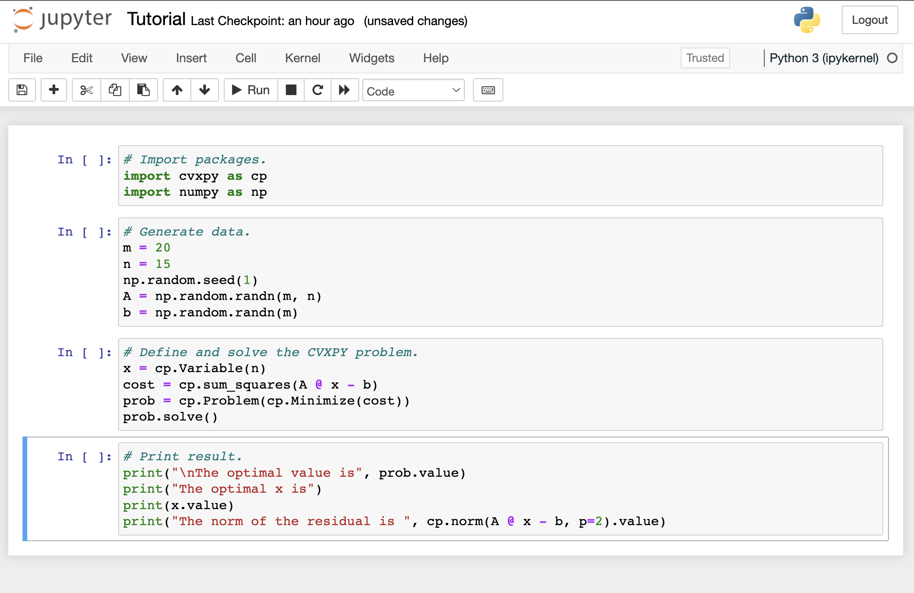

You should see the following:

Slide 6
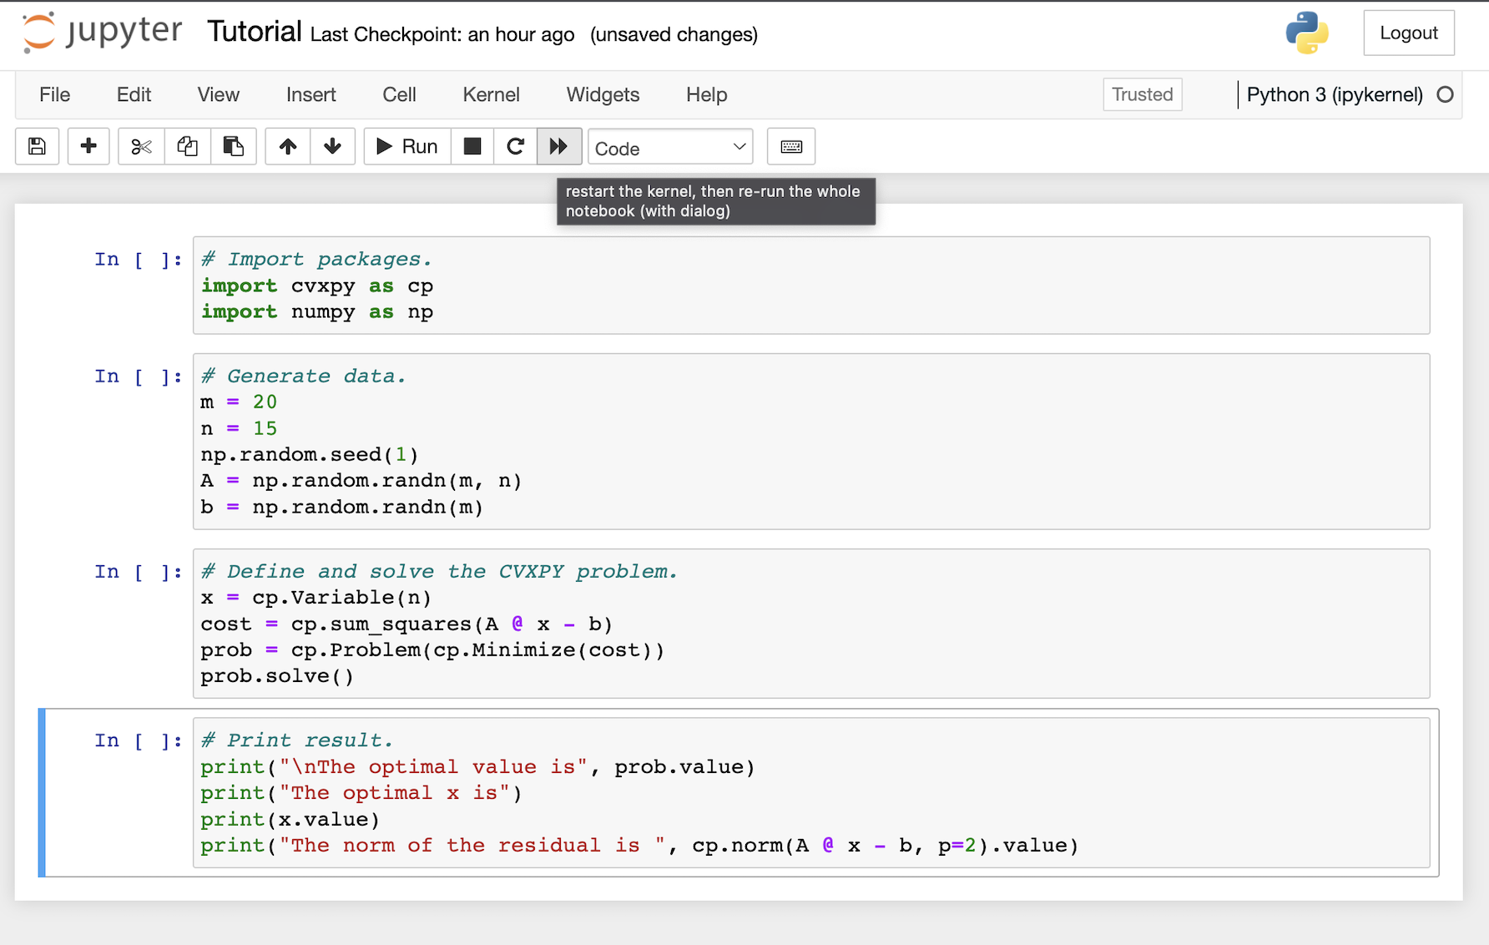
Click on restart notebook:

Slide 7
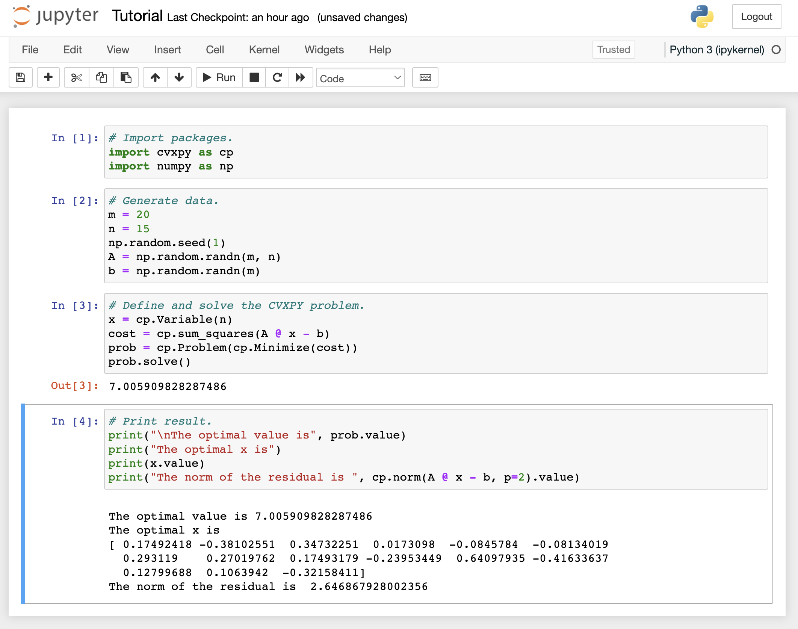
You should see this:

Slide 8
Complete!!!
You have completed installing CVXPY!
To find out more resources on using CVXPY, as well as examples on what to code, consult the website:
https://www.cvxpy.org/examples/index.html

